Slide 1
Battery Model As First Case Study
A compact validation case before the nonlinear cookie-factory energy system
Experimental design
Why include it
Clean storage use case: electricity-price arbitrage with SOC and power limits
Shows the same thesis question in a simpler, explainable setting
Keep SAC, model architecture, training budget and price windows fixed
Train each reward variant over multiple seeds
Evaluate on unseen 24h windows
Compare against Mathematical/IPOPT baseline
Use the same metrics for battery and cookie-factory studies
MDP formulation
State: SOC, current price, time, feasible charge/discharge limits, 24h forecast
Action: continuous a in [-1, 1], scaled to battery power
Reward: -grid cost – (infeasible-action penalty)
Dynamics: SOC(t+1) = SOC(t) + P_actual * dt / E_max

Slide 2

Battery Model Mathematical Formulation
Objective Function
………………………………………………………………………(1)
Power Gating Constraint
……………………………………………………(2)
Where the smoothing terms are defined as:
Actual Power and SOC Dynamics
……………………………………..…………………………...……(3)

Slide 3

Decision Variables & Bounds
Four variables are defined at each time step t = 0, …, T−1, each with explicit physical bounds:
1
2
Control Input u_{t}
State of Charge SOC_{t}
Normalized charge/discharge command.
Fractional energy level of the battery.
3
4
Grid Power P_{t}
Effective Power P_{t}^{act}
Scheduled power exchange with the grid.
Battery power after efficiency losses.
Sign convention: P_{t} > 0 → grid import (cost); P_{t} < 0 → grid export (revenue).

Slide 4

Objective: Minimize Electricity Cost (1)
Minimize total energy procurement cost over the horizon T:
Variable Legend
π_{t} — electricity price at time t
P_{t} > 0 — import; pay π_{t}.Pt
P_{t} < 0 — export; earn |π_{t} .Pt|
T — optimization horizon length
where π_{t} is the electricity spot price at step t. The optimizer exploits low-price periods to charge and high-price periods to discharge, reducing net grid cost.

Slide 5


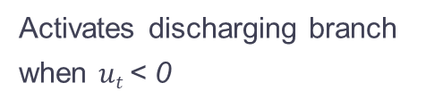

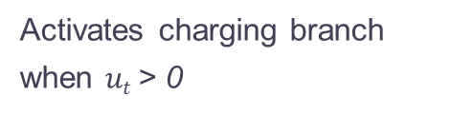


Constraints: Smooth power mapping (2)
Non-differentiable switching at SOC limits is approximated by smooth tanh-based gates, enabling gradient-based solvers.
The gated power map becomes:
$σ$_{k}($ut−ε)$
$σ$_{k}($−ut−ε)$
$$σ\text{k}\text{(}0.995−SOCt)$$
$σ$_{k}(SOC_{t}$−0.005)$
Activates charging branch when $ut$> 0
Activates discharging branch when $ut$< 0
Suppresses charging near full (SOC≈1)
Suppresses discharging near empty (SOC≈0)
Parameters: dead-band offset $ε$ = 0.0025; steepness k controls sharpness of the gate transition. Larger k approaches a hard switch.

Slide 6
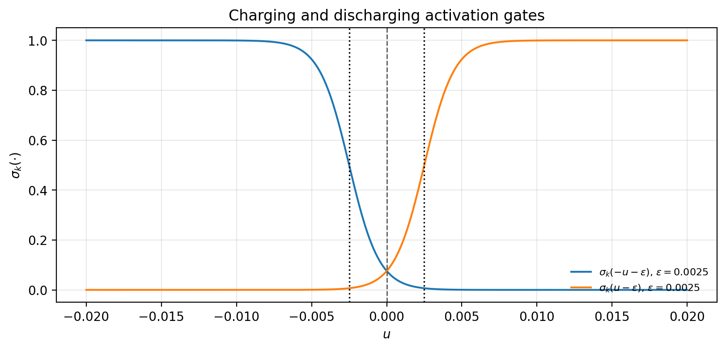
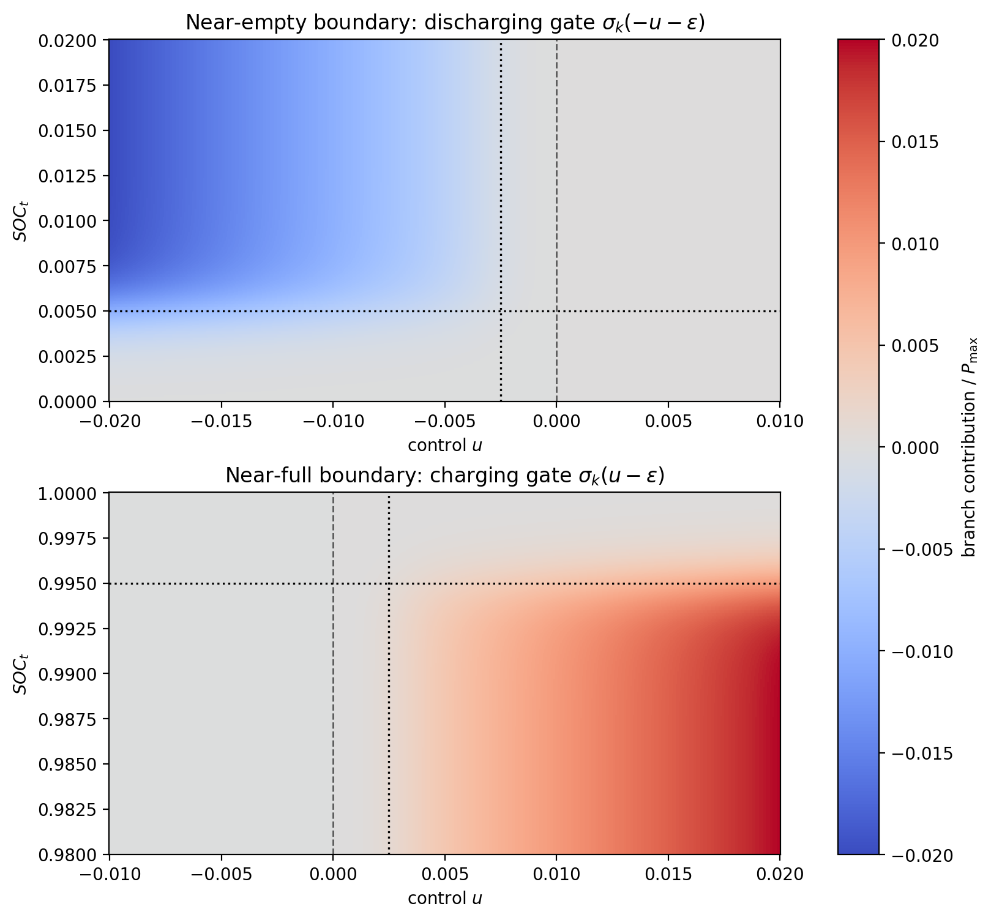
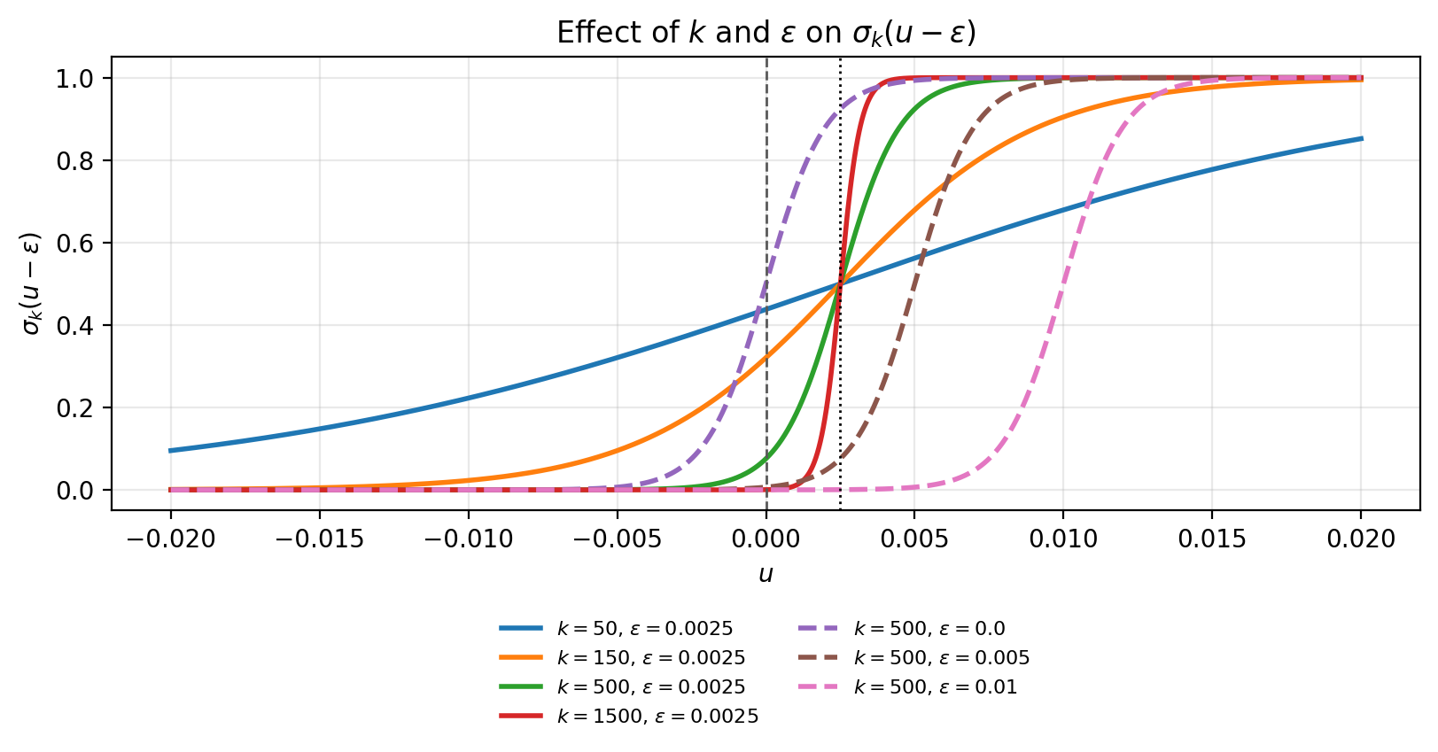
Fig. 1: Charging and discharging activation gates with a small deadband around u = 0.
Fig. 3: SOC boundary behavior, suppressing discharge near empty and charge near full.
Fig. 2: Effect of k and epsilon on gate sharpness and threshold shift.

Slide 7
New Constraint: Terminal SOC Bound
The battery must not finish the optimization horizon below the minimum reserve level.
Mathematical form
0.5 <= SOC(T-1) <= 1.0
equivalently: SOC(T-1) >= SOC_min, SOC_min = 0.5
Pyomo implementation
model.SOC[len(model.SOC)-1].bounds = (0.5, 1.0)
Prevents exploiting the final step by emptying the battery.
Keeps the battery ready for the next 24 h operating window.
RL counterpart
penalty_T = lambda_T * max(SOC_min - SOC_T, 0)
The learned policy is penalized only when terminal SOC is below the same minimum reserve.

Slide 8




Constraints: Efficiency Model & SOC Dynamics (3)
Efficiency Map
State-of-Charge Recursion
A factor $η$ is applied to both charge and discharge:
With Δt = 3600 s and capacity E_{max}:
Implementation uses $η$ = 0.9.
Each step integrates effective battery power into the energy state, enforcing causality across the horizon.

Slide 9
Why Soft Actor-Critic (SAC)?
The control task needs continuous setpoints, sample-efficient learning, and stable exploration under changing electricity prices
Algorithm
Why it was not the main choice
Why SAC fits this thesis
Q-learning
Works best for small discrete states/actions; continuous battery power would need coarse discretization.
Continuous actor outputs the charge/discharge setpoint directly
Off-policy replay reuses simulation data efficiently
Entropy term keeps exploration alive during price spikes and SOC trade-offs
After training, inference is a direct state-to-action mapping
Same algorithm family can scale from battery power to cookie-factory continuous controls
DQN
Deep version of Q-learning, but still mainly discrete-action;
PPO
Can handle continuous actions and is stable, but on-policy learning usually needs more fresh simulation data.
TD3
Strong deterministic baseline, but SAC gives more deliberate exploration through entropy regularization.

Slide 10
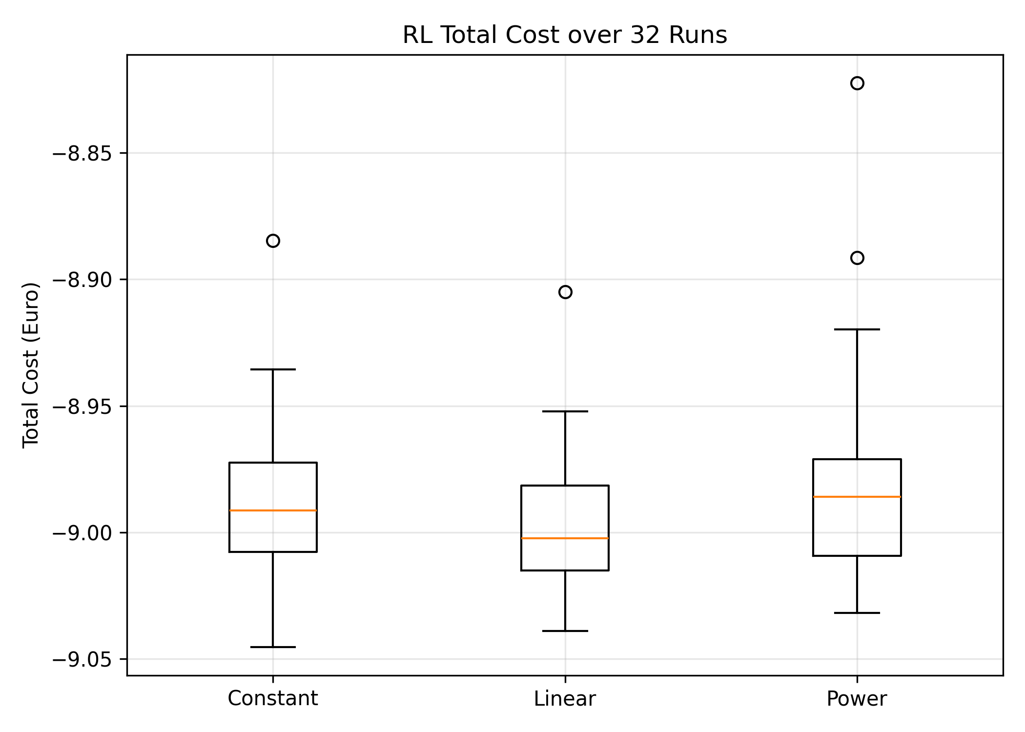
Analysis of RL Battery Optimization Box Plot (32 Runs)
Fig.: Distribution of total cost from 32 RL models trained with identical hyperparameters and evaluated over the same time horizon.
* Mathematical Optimization Cost: -10.12 €

Slide 11
Analysis of RL Battery Optimization Box Plot (32 Runs)
The linear learning rate schedule performs best because it achieves the lowest median cost and maintains a tight distribution across runs, indicating stable and reliable convergence. The linear decay allows large updates during early exploration and smaller updates for fine policy refinement later in training.
Strengths:
31/32 runs (96%) achieved near-optimal performance
Stable and consistent learning behavior
Model is robust to random initialization
Weaknesses:
4% chance of suboptimal convergence (1 outliers)
Optimality of the learned policy cannot be guaranteed

Slide 12
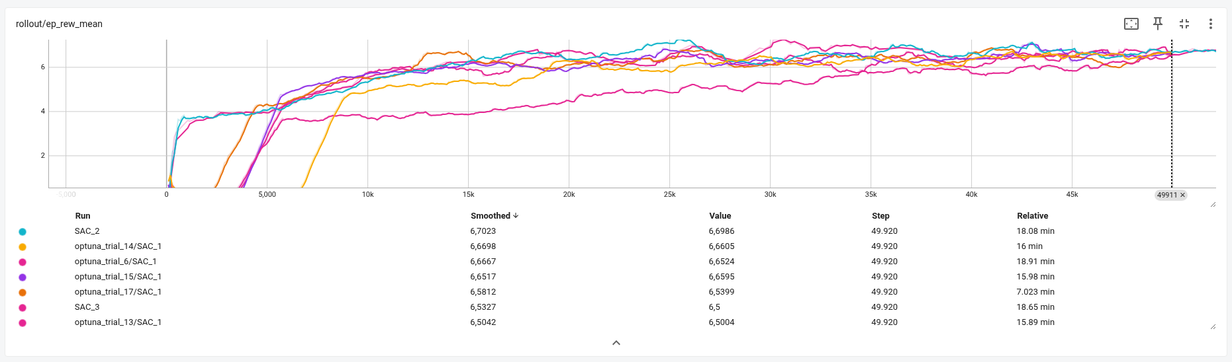
Hyperparameter Tuning: Training Performance Comparison
Fig: Comparison of episode rewards across multiple SAC training runs with different hyperparameter configurations.

Slide 13
Computational Time Comparison
Method | Time
RL Training | ≈ 16 minutes
RL Policy Execution | 0.02 seconds
Optimization | 0.16 seconds
Although RL requires higher upfront training time, the decision-making during operation is significantly faster than classical optimization, making RL suitable for real-time control applications.

Slide 14
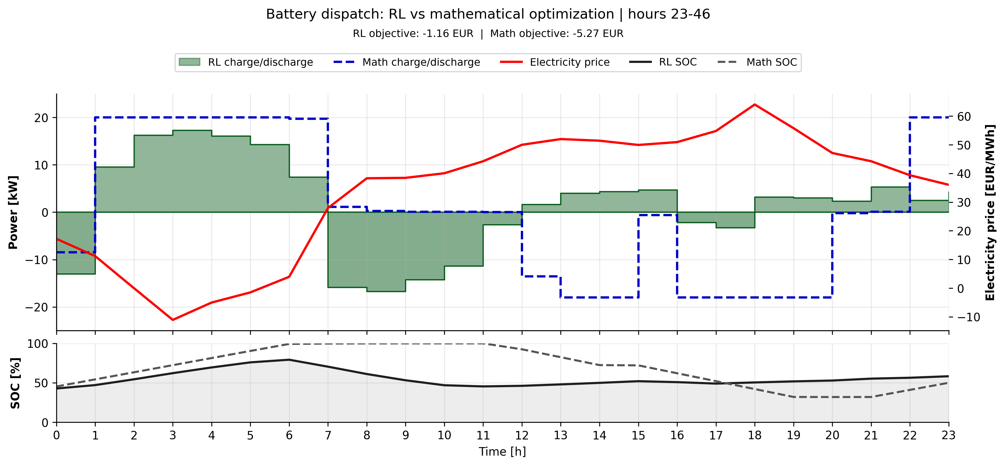
Fig: Visualization of system dynamics and control for one trajectory (real price).

Slide 15
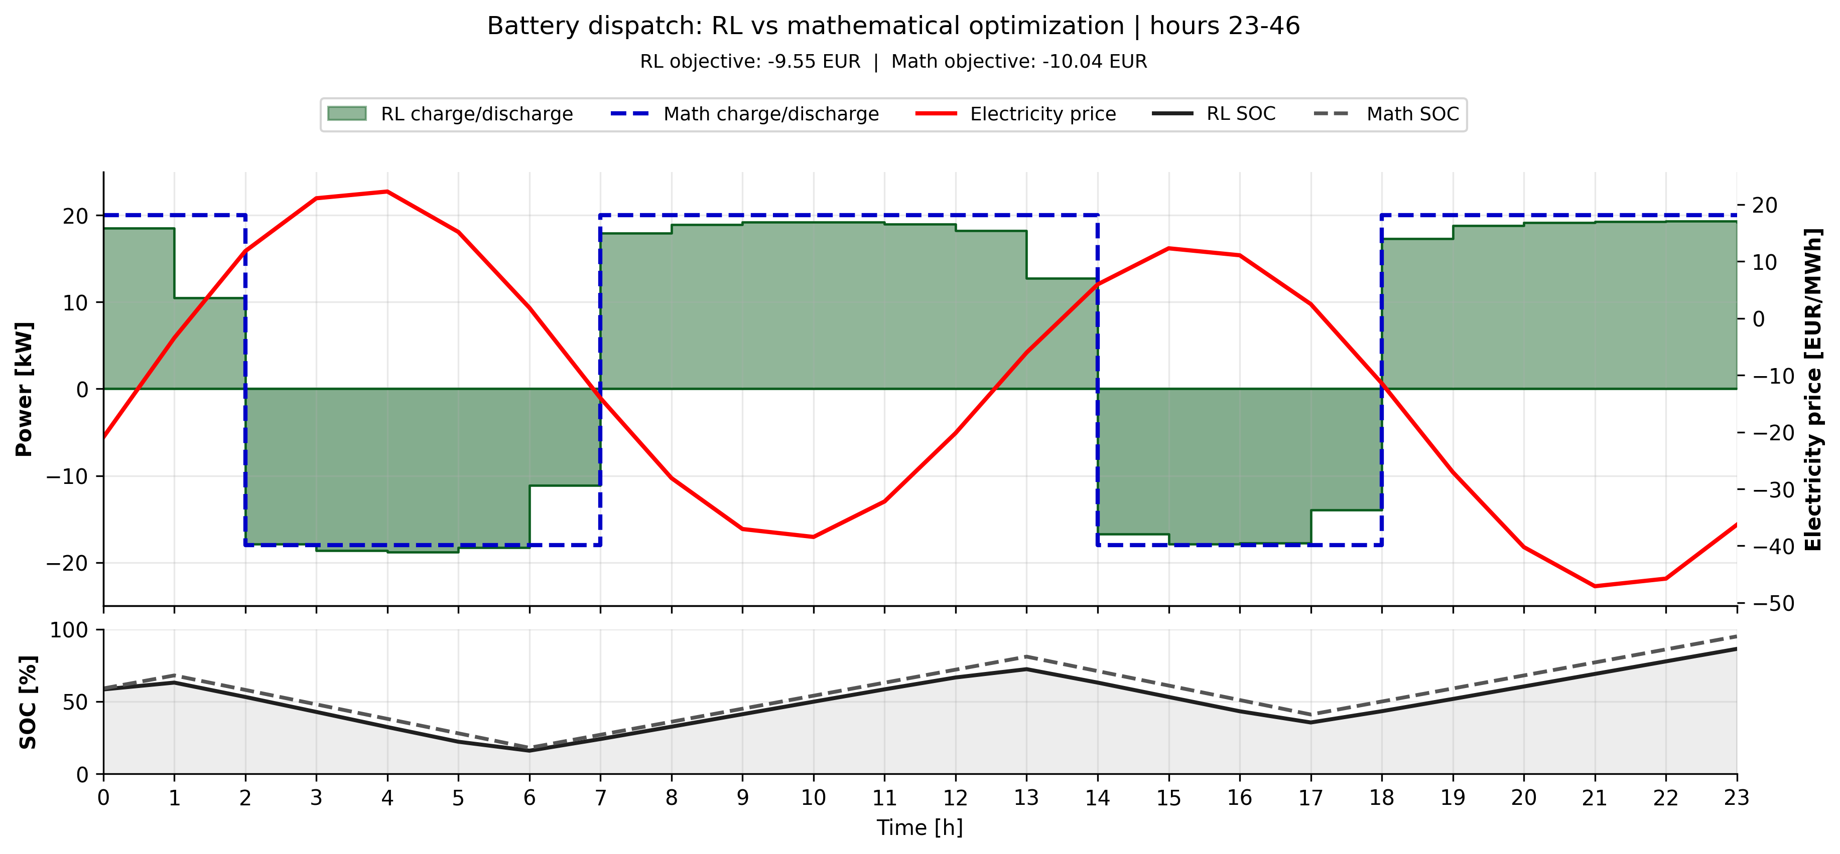
Fig: Visualization of system dynamics and control for one trajectory (price model).

Slide 16
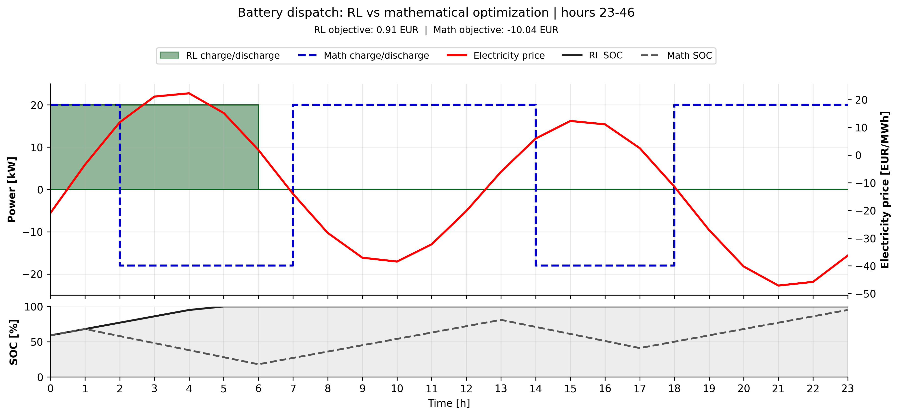
Fig: Visualization of system dynamics and control for one trajectory (price model).

Slide 17
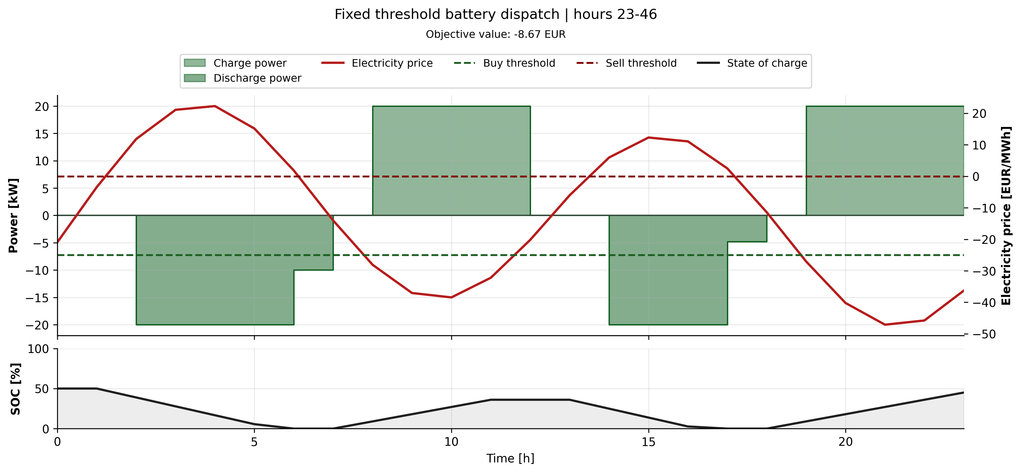
Fig: Visualization of fix threshold for one trajectory (price model).

Slide 18
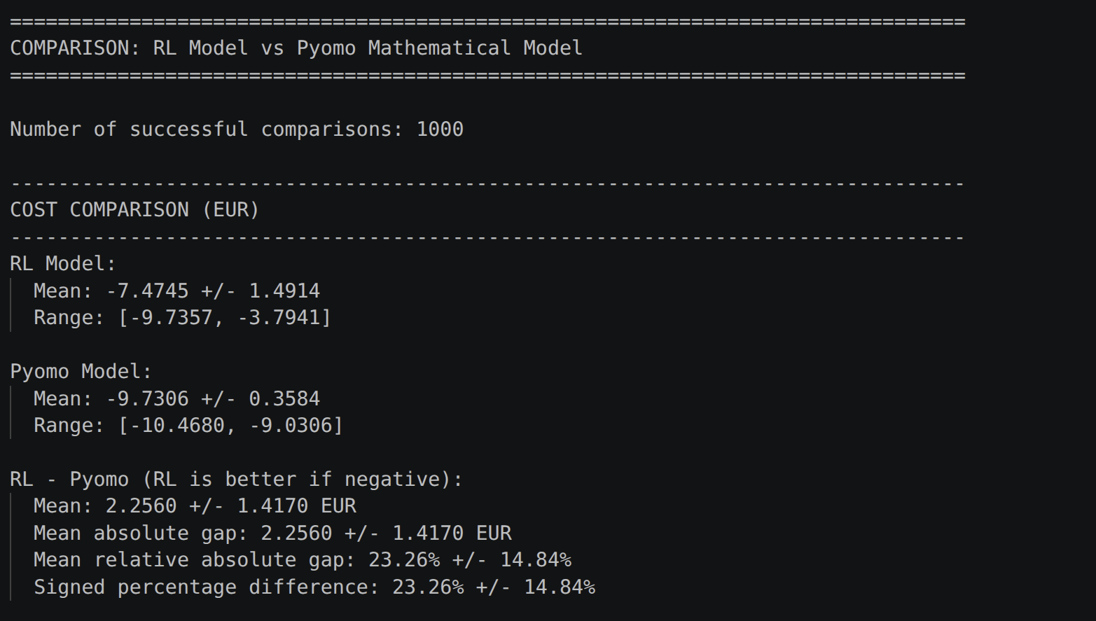
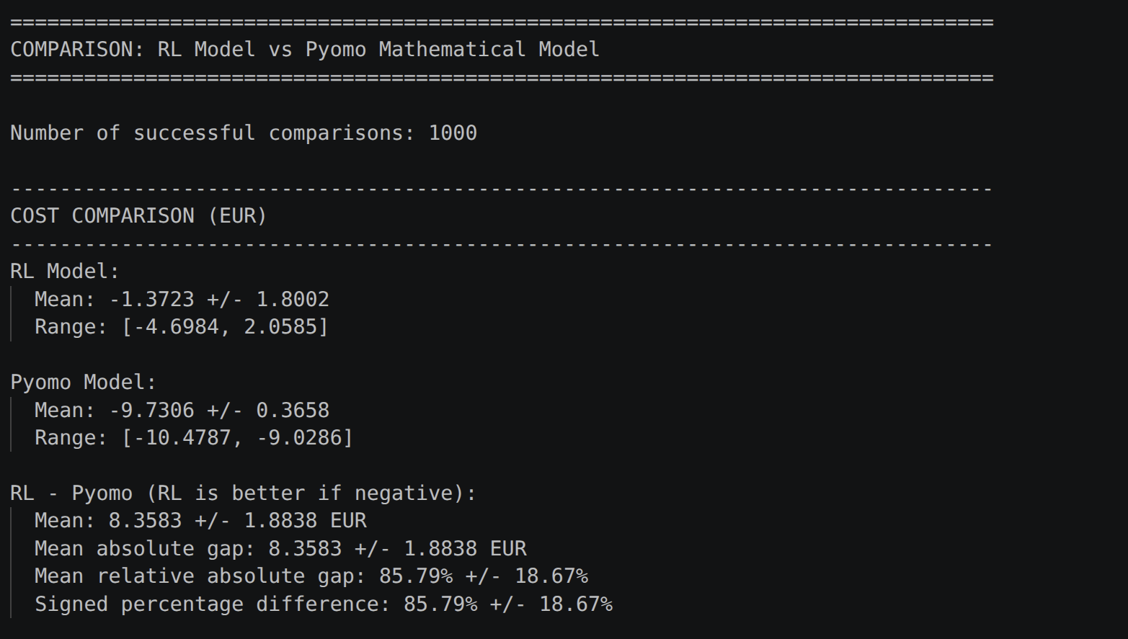
Using SAC model
Using TD3 model

Slide 19
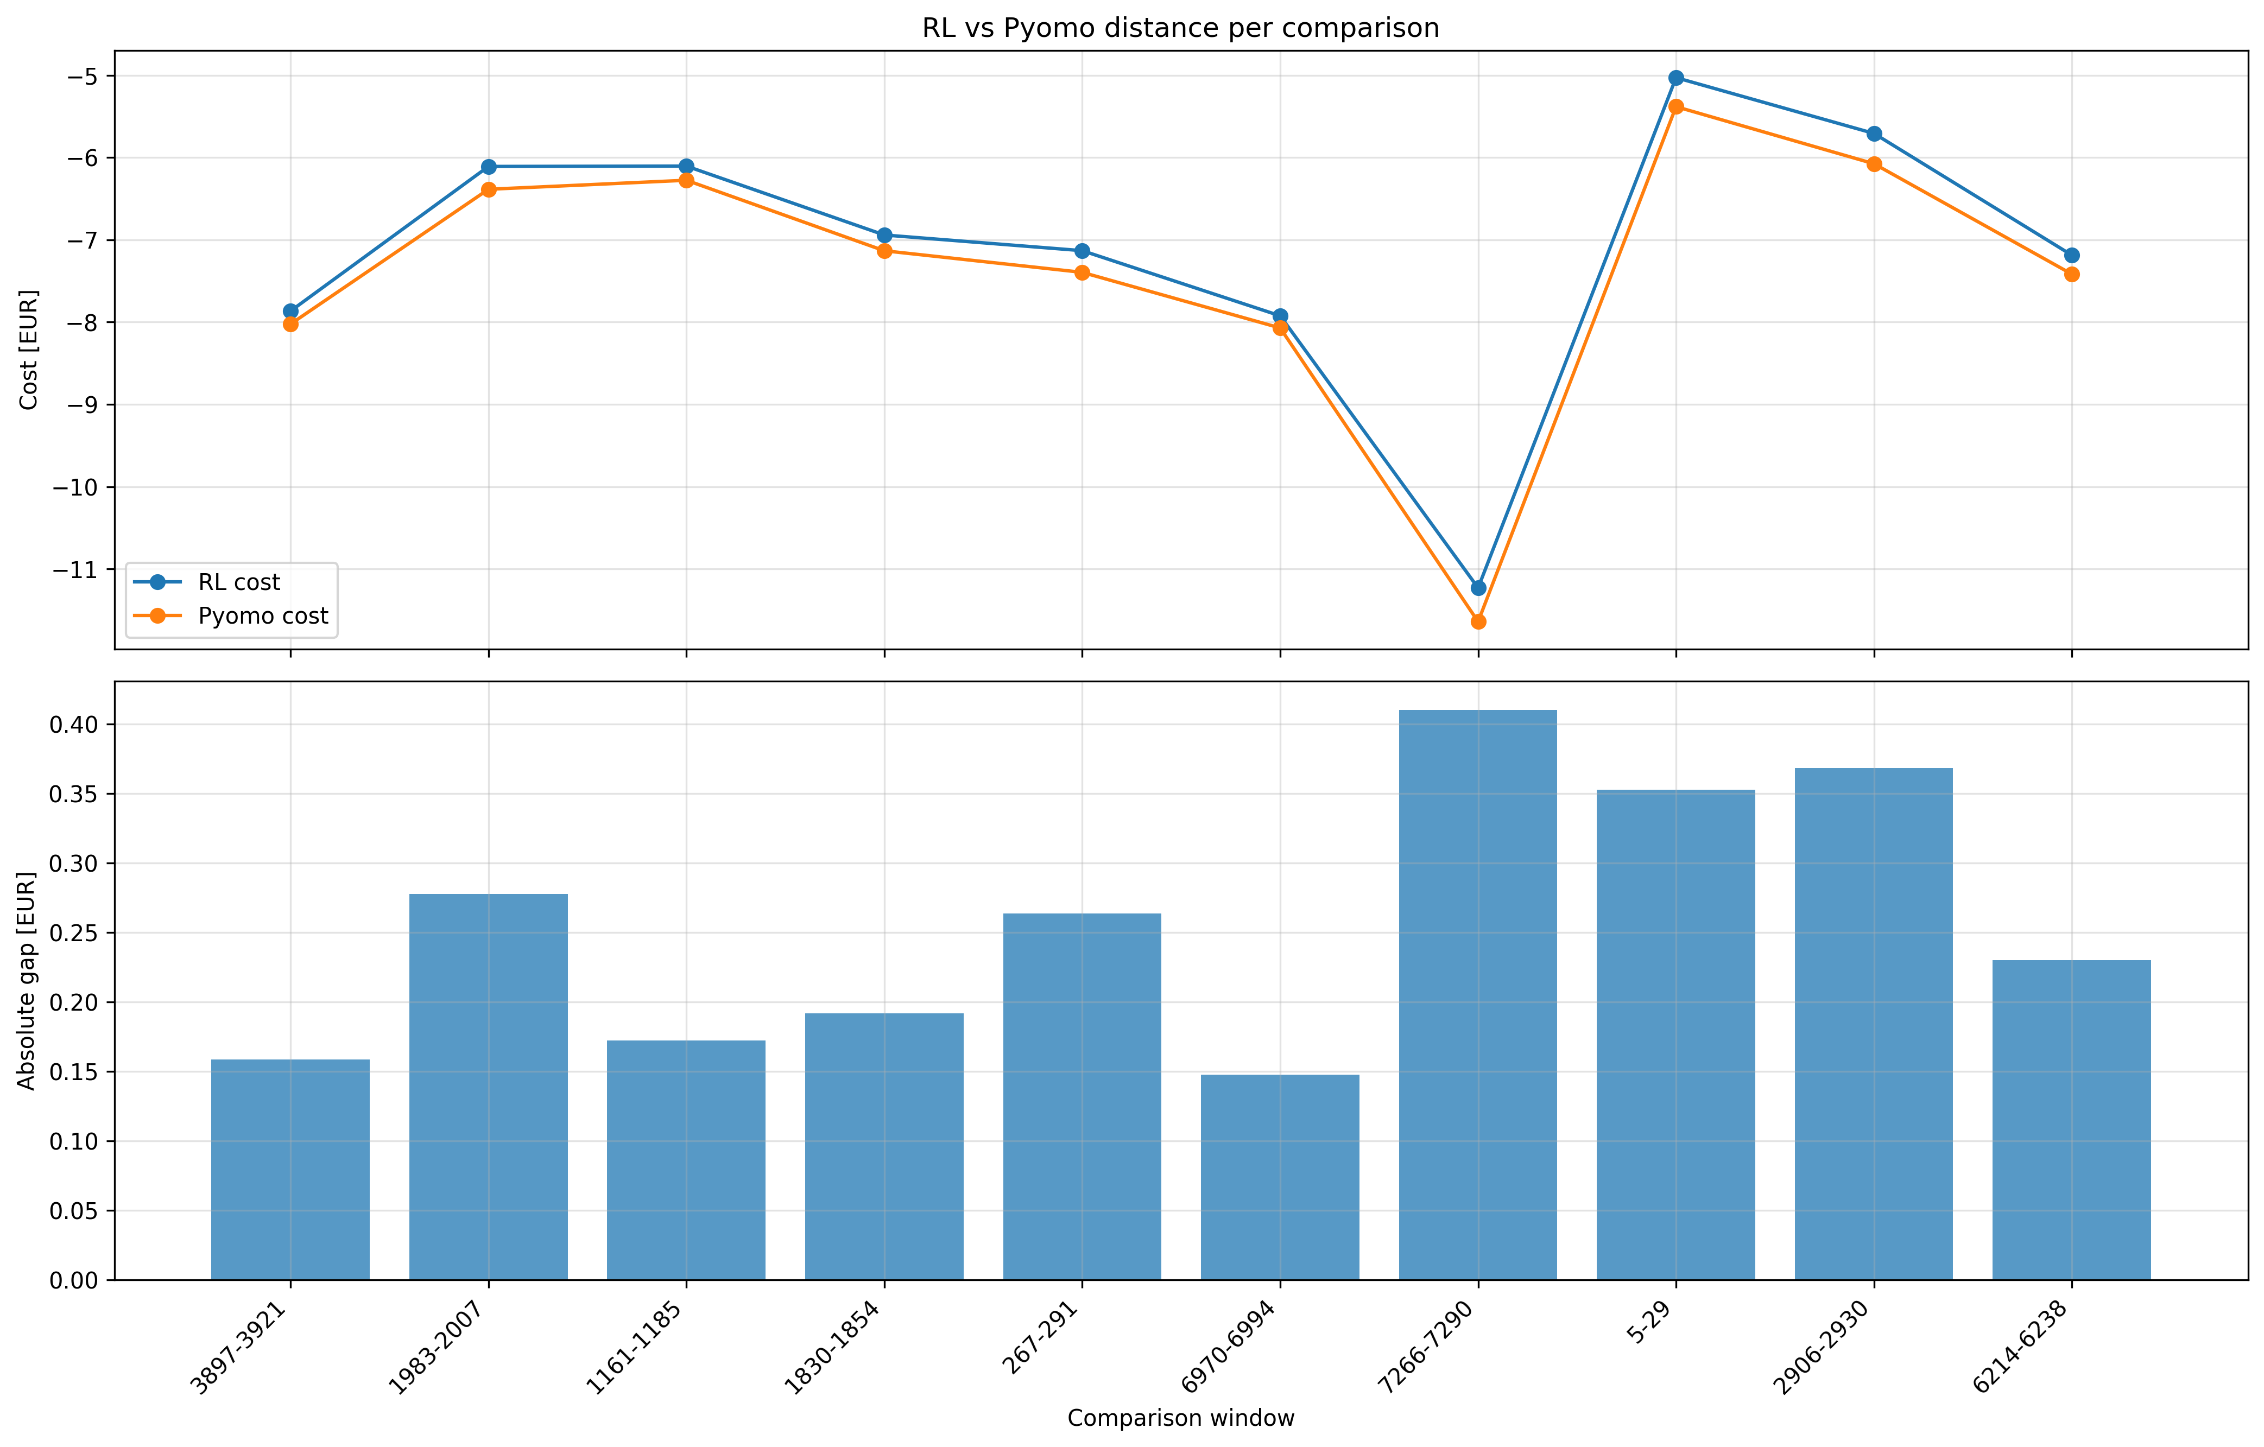
Multiple Runs: Inference Performance Comparison

Slide 20
Thank You!
I appreciate your time and attention.

Slide 21
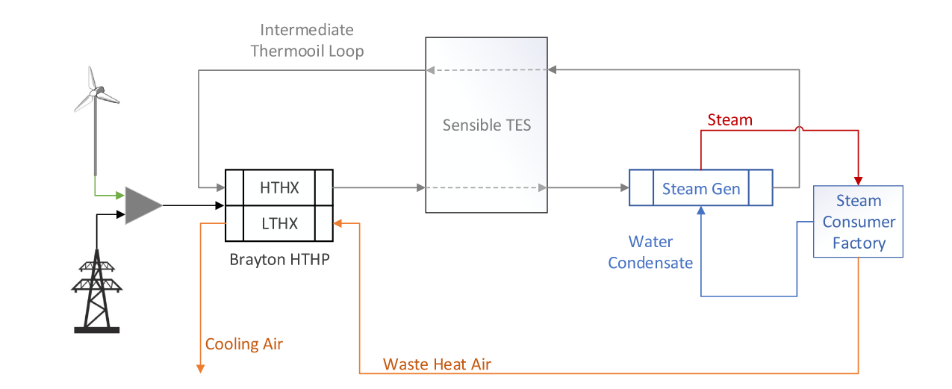
Cookie Factory
Fig: Illustration of the investigated industrial energy conversion system for electrified steam generation. The system consists of a HTHP, a TES and a SG, where the HTHP is powered by electricity from a wind turbine or the power grid. The HTHP uses waste heat air stream as a heat source and enables charging and discharging of the TES via an intermediate thermal oil stream. Furthermore, constant heat demand for the steam consumer factory must be satisfied.

Slide 22
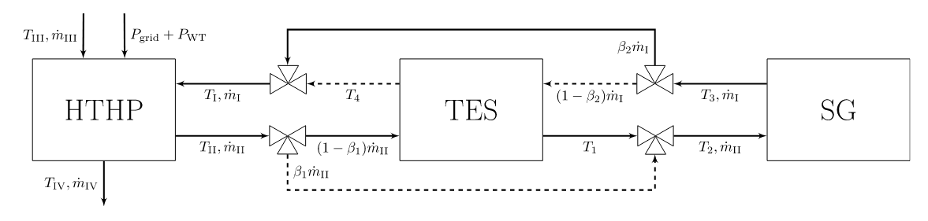
Fig: Detailed flow chart of studied system including HTHP, TES and SG. HTHP and SG are represented by polynomial surrogate models, while TES is modeled by an effectiveness model. An adjustable fluid bypass β1 ∈ [0, 1] is used to control the heat input to the TES and SG, conversely the bypass β2 ∈ [0, 1] regulates the heat input to the HTHP depending on the thermal state Ts of the TES and SG outlet stream. The solid and dashed lines indicate the charging and discharging mode in a simplified way. In addition, simultaneous charging and discharging is not allowed. For example, charge mode is β1 ∈ [0, 1), β2 = 1, discharge mode implies β2 ∈ [0, 1), β1 = 1, and idle mode represents β1 = β2 = 1

Slide 23
Second Use Case: RL vs Mathematical Optimization
Same time horizon comparison for the cookie-factory energy system; prioritize decision time for real-time operation
Primary result: computation time
Objective value (in €)
922.5x faster
RL
2669.56
Optimization
2418.92
RL: 0.02 s | Optimization: 18.45 s
Objective gap: +250.64 (10.4% higher for RL)
This is the strongest argument for RL in the second use case: once trained, the policy gives a near-instant setpoint decision while the mathematical optimizer must solve the nonlinear problem again.
The mathematical optimizer still gives the better objective value; the current RL value is a speed-quality trade-off, not an optimality claim.

Slide 24
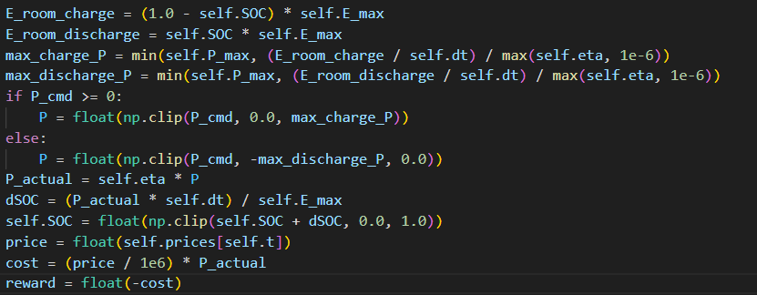
Reward Shaping- reward 1

Slide 25
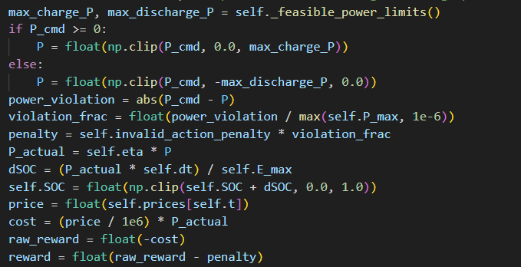
Reward Shaping- reward 2

Slide 26
slides for RL(how it works)
Plot for hyperparameter tuning comparision
Create a table of content.
Number of pages you can write
Template (description)
American or british english to use
Email subject format
Time for each model.

